Slide 2
SGNA Sets the Standard
An Introduction to SGNA Practice Documents (for GI Nursing Professionals)

Slide 3
About SGNA’s Practice Documents
Practice Documents include:
  Position Statements (SGNA’s position/standing on a topic/issue)
  Standards and Guidelines (Formalized guidance on a topic/issue)
Developed and/or revised by GI nursing professionals – SGNA’s Practice Committee – through a collaborative process
Support SGNA’s mission and vision by providing a framework for the practice of gastroenterology/endoscopy nurses
Are adopted by GI nursing professionals in every practice setting, across the U.S.
Notes:
What makes SGNA practice documents beneficial and unique is that they are developed by GI nursing professionals for GI nursing professionals

Slide 4
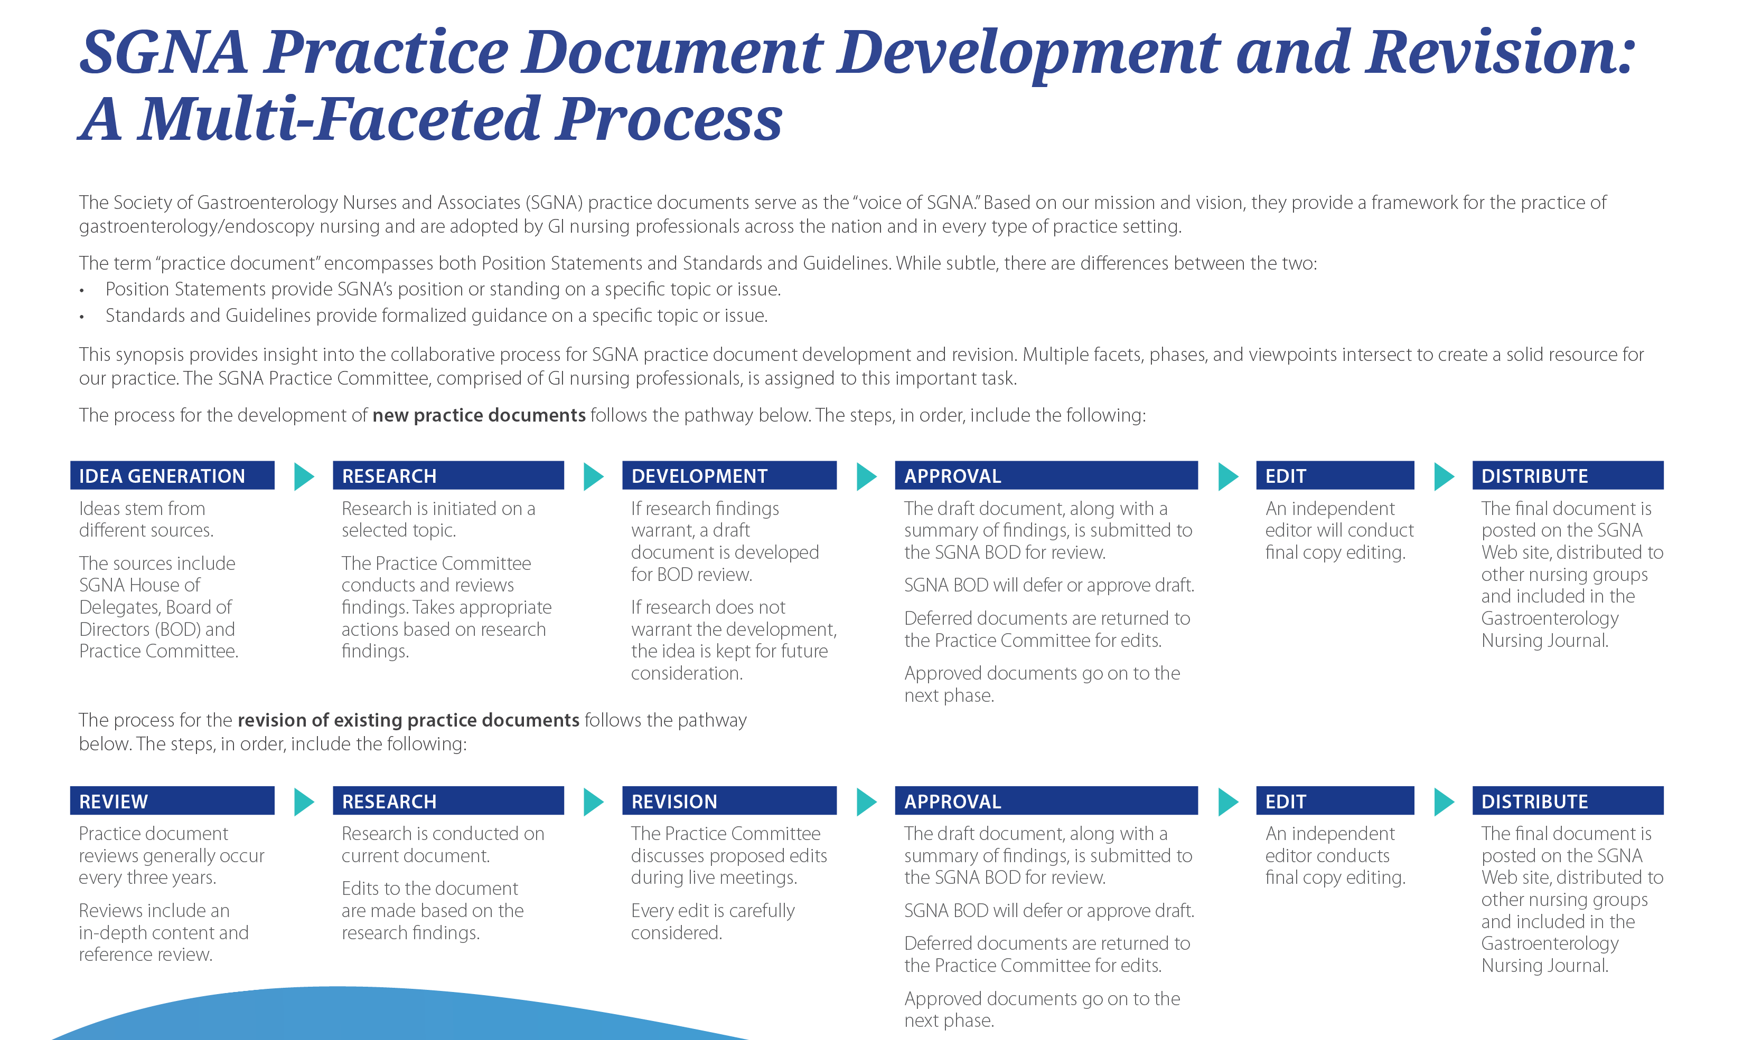

Slide 5

What Topics do the Practice Documents Cover?
SGNA's Practice Documents address issues directly affecting the practice of gastroenterology nursing, within categories that include:
Infection Prevention
Nursing Practice and Role Delineation
Procedures
Safety
Sedation and Analgesia

Slide 6
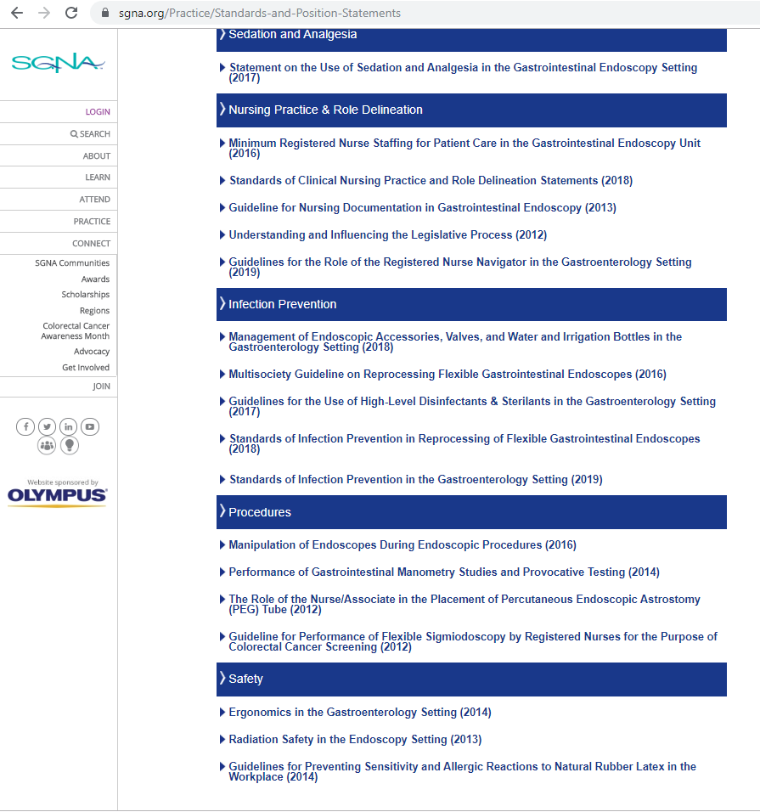
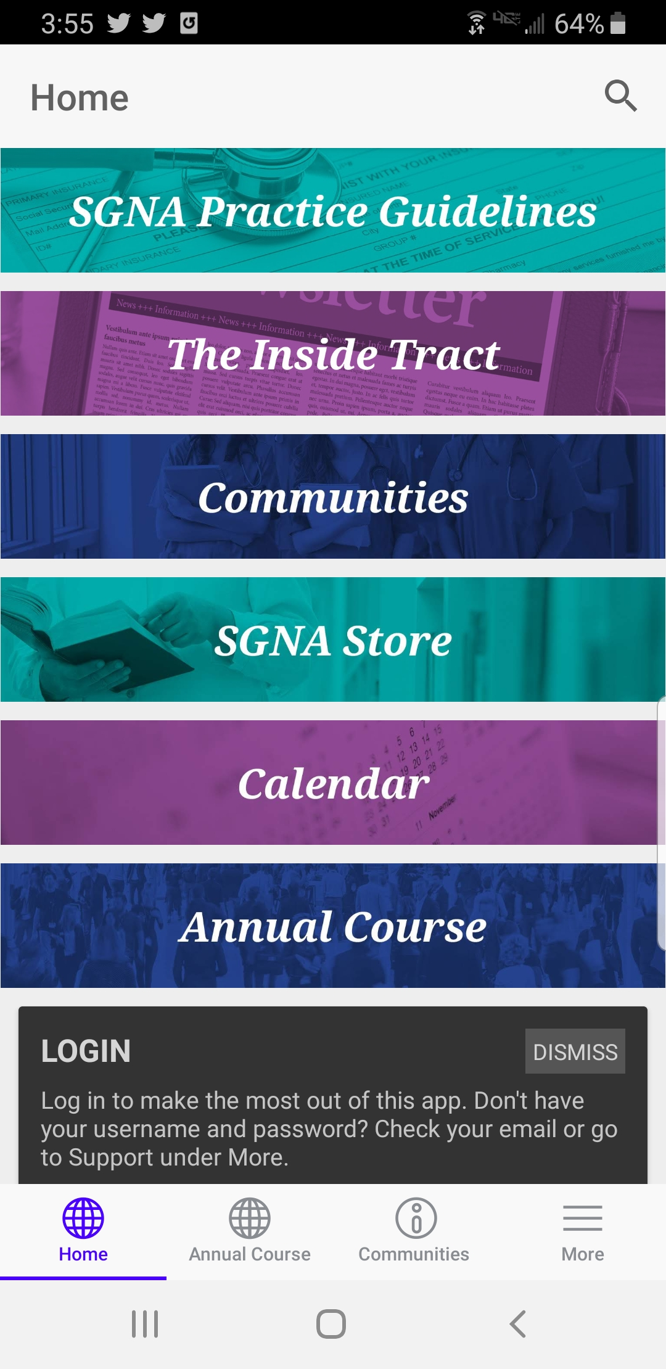
Accessing the Practice Documents
SGNA’s website: www.sgna.org/Practice/Standards-and-Position-Statements
SGNA mobile app: search “SGNA on the Go”

