Slide 2
SGNA Sets the Standard
An Introduction to SGNA Practice Documents (for GI Nursing Professionals)

Slide 3
About SGNA’s Practice Documents
Practice Documents include:
Position Statements (SGNA’s position/standing on a topic/issue)
Standards and Guidelines (Formalized guidance on a topic/issue)
Developed and/or revised by GI nursing professionals – SGNA’s Practice Committee – through a collaborative process
Support SGNA’s mission and vision by providing a framework for the practice of gastroenterology/endoscopy nurses
Are adopted by GI nursing professionals in every practice setting, across the U.S.
Notes:
What makes SGNA practice documents beneficial and unique is that they are developed by GI nursing professionals for GI nursing professionals

Slide 5
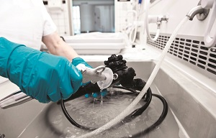
What Topics do the Practice Documents Cover?
SGNA's Practice Documents address issues directly affecting the practice of gastroenterology nursing, within categories that include:
Infection Prevention
Nursing Practice and Role Delineation
Procedures
Safety
Sedation and Analgesia

Slide 6
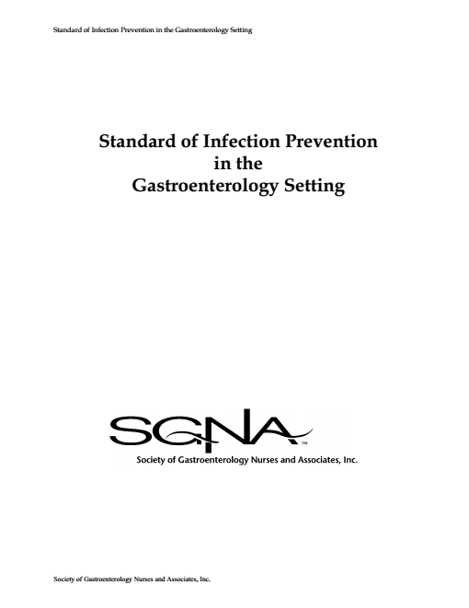
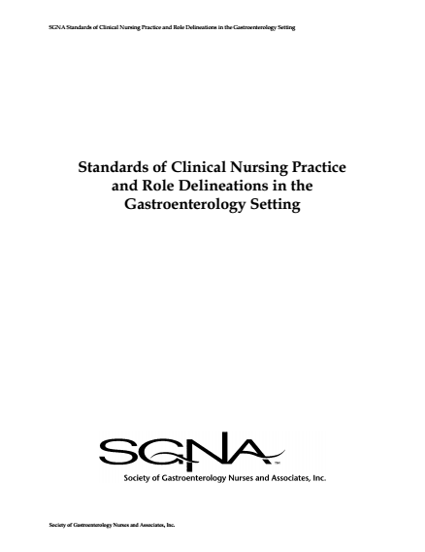
What are the Key Components?
Acknowledgements
Contributors
Disclaimer
Preface or Background
Definitions
Summary
References
Recommended Reading
Position, Standards of Practice, Role Delineation or Clinical Instruction/ Recommendations*
Notes:
*This content will vary based on the type of practice document. Positions are found within position statements. Standards of practice, recommendations and similar content is found within standards & guidelines documents.

Slide 7
Next Steps
Now that you know more about the practice documents, what are some actions you can take?
Read the practice documents and consider their applicability to your unit/facility
Share with your unit and educate your colleagues
Volunteer to lead an educational session(s) with your team
Share with your manager or administrator (with SGNA resources)

Slide 8
Justifying the Guidelines
With managers/administrators: Emphasize that they are evidence-based and objective, written by GI nursing professionals for GI nursing professionals on issues specific to the specialty
With accrediting body representatives:
Share SGNA resources
Be prepared to speak to the content of the practice document and how your unit has chosen to follow it
Be confident. Surveyors may not be familiar with these documents; you can help to educate them. Facilities are obligated to follow their own policies and procedures. Accrediting bodies are trying to make sure facilities are following their processes.

Slide 9
SGNA Resources – Justifying the Guidelines
Now accessible through the SGNA website:
“Setting the Standard in Our GI Unit” – PowerPoint Presentation (with suggested talking points)
Practice Documents FAQ (PDF)
Practice Document Development & Revision Process (PDF)
Practice Document Flyer (PDF)
Email copy for unit/facility decision-makers

