Slide 3
“I felt so lost and overwhelmed when I first started working in GI. Having SGNA resources really helped me navigate the new role. Being an SGNA member has definitely helped me become a better nurse in such a specialized area.”
Stephanie Byelick, Morristown Medical Center

Slide 4
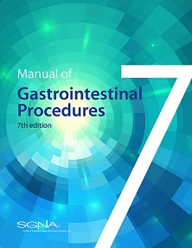
A Must-have Reference Manual for Your Facility
Manual of Gastrointestinal Procedures (7th Edition)
Featuring 60+ GI procedures (including descriptions), indications, contraindications, pre-, intra- and post- procedure assessment, care and responsibilities, patient teaching, equipment, and potential complications.
This is made available through an educational grant from Medivators.
Members save 50%
Visit the store at now at sgna.org

Slide 8
Get the Latest SGNA News & Updates
@SGNAonline
Society of Gastroenterology Nurses and Associates
@SGNAonline
SGNAhq

Slide 9
““SGNA was extremely helpful in providing easily accessible and current information. This encouraged me to keep current and provide science-based info to my coworkers.”
Katherine Barton, Maine Medical Center

Slide 11
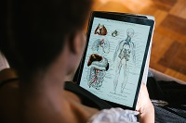
Introducing: Student Membership
Students are now welcome to join the SGNA community and to learn more about the world of GI nursing.
Student membership includes access to:
Webinars and eLearning programs
Practice documents
Discounts on foundational publications
An online community of experienced GI nurses
Annual Student Membership = $40 (with university email address)

Slide 13
eLearning Especially for Associates
Associates Program
Build knowledge on topics ranging from endoscope reprocessing to anatomy & physiology
Earn 7.0 contact hours from CBSPD
Receive GI Technical Specialist (GTS) recognition
Advanced Associates Program
Explore case studies and additional resources that help strengthen critical thinking skills
Earn 4.5 contact hours from CBSPD
Receive Advanced GI Technical Specialist (AGTS) recognition
Both programs generously supported by an educational grant from Fujifilm Medical Systems U.S.A., Inc.
Members save 50% on both programs | Visit the store at now at sgna.org

Slide 14
Exclusive Career
SGNA Members: Access or post new employment opportunities, career coaching and job-search resources at sgna.org

Slide 15
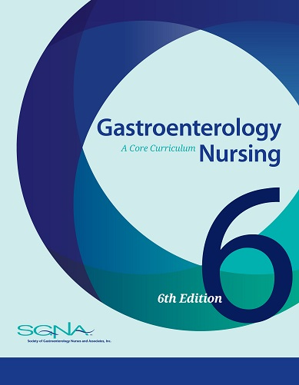
A Foundational Resource for Your Team
Gastroenterology Nursing: A Core Curriculum (6th Edition)
The latest edition and features updates to all 32 chapters. This foundational resource is designed to meet the needs of all members of the gastroenterology nursing team within any GI/endoscopy facility.
Members save 50%
Visit the store at now at sgna.org

